Slide 1
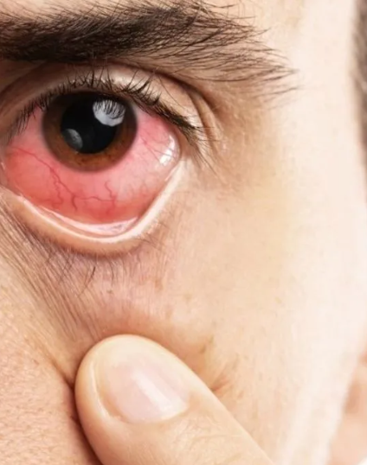
Web-Based Diabetic Retinopathy Detection System
Presented By : - Luxshan S.

Slide 2
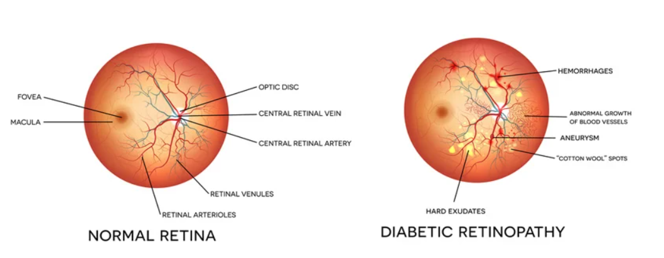
Overview
Scope of this System to develop a user-friendly web-based platform that allows users to upload retinal images and receive detailed analysis regarding diabetic retinopathy. By integrating a pre-trained machine learning model, users can trust the system to accurately classify images into various stages of retinopathy. With Google Sign-In authentication, security is ensured, and users can easily manage their profiles and access historical data.

Slide 3
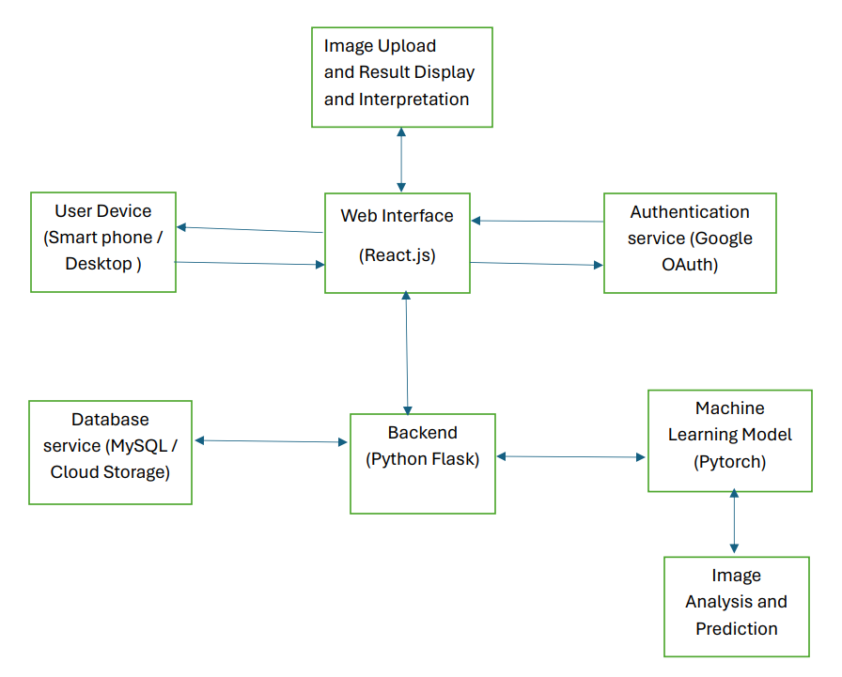
Block Diagram

Slide 4
Features and Functionalities
1. User Authentication Google Sign-In:
Enjoy secure access to the system with Google OAuth integration.
User Profile Management: Easily manage user profiles, including login credentials and usage history.
2. Image Upload Interface:
Intuitive interface for users to upload retinal images.
Supported Formats: System supports common image formats (JPEG, PNG).
3. Machine Learning Engine Model Integration:
Pre-trained machine learning model (trained on Kaggle dataset) for image analysis.
Prediction: Classify diabetic retinopathy into 5 classes: 'No DR', 'Mild', 'Moderate', 'Severe', 'Proliferative DR’.

Slide 5
Features and Functionalities
4. Image Analysis and Results Processing:
System processes uploaded images using the ML model.
Result Display: Analysis results displayed to users, indicating the severity of diabetic retinopathy.
5. Data Storage
User Data: Maintain database of user data, including uploaded images and analysis history.
6. User Interface
Dashboard: User-friendly dashboard for managing uploads, viewing results, and accessing analysis data.

Slide 6
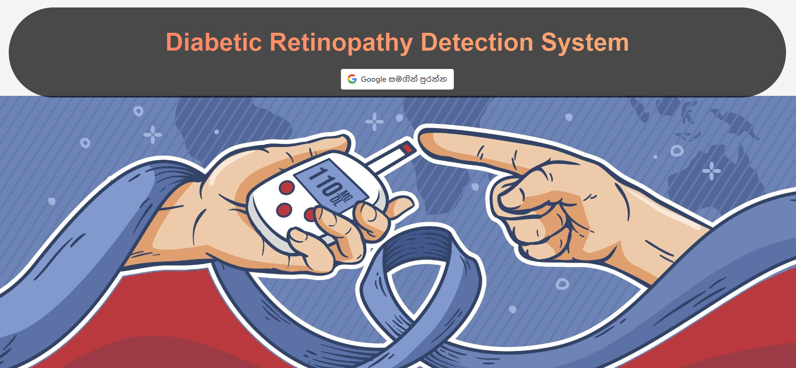
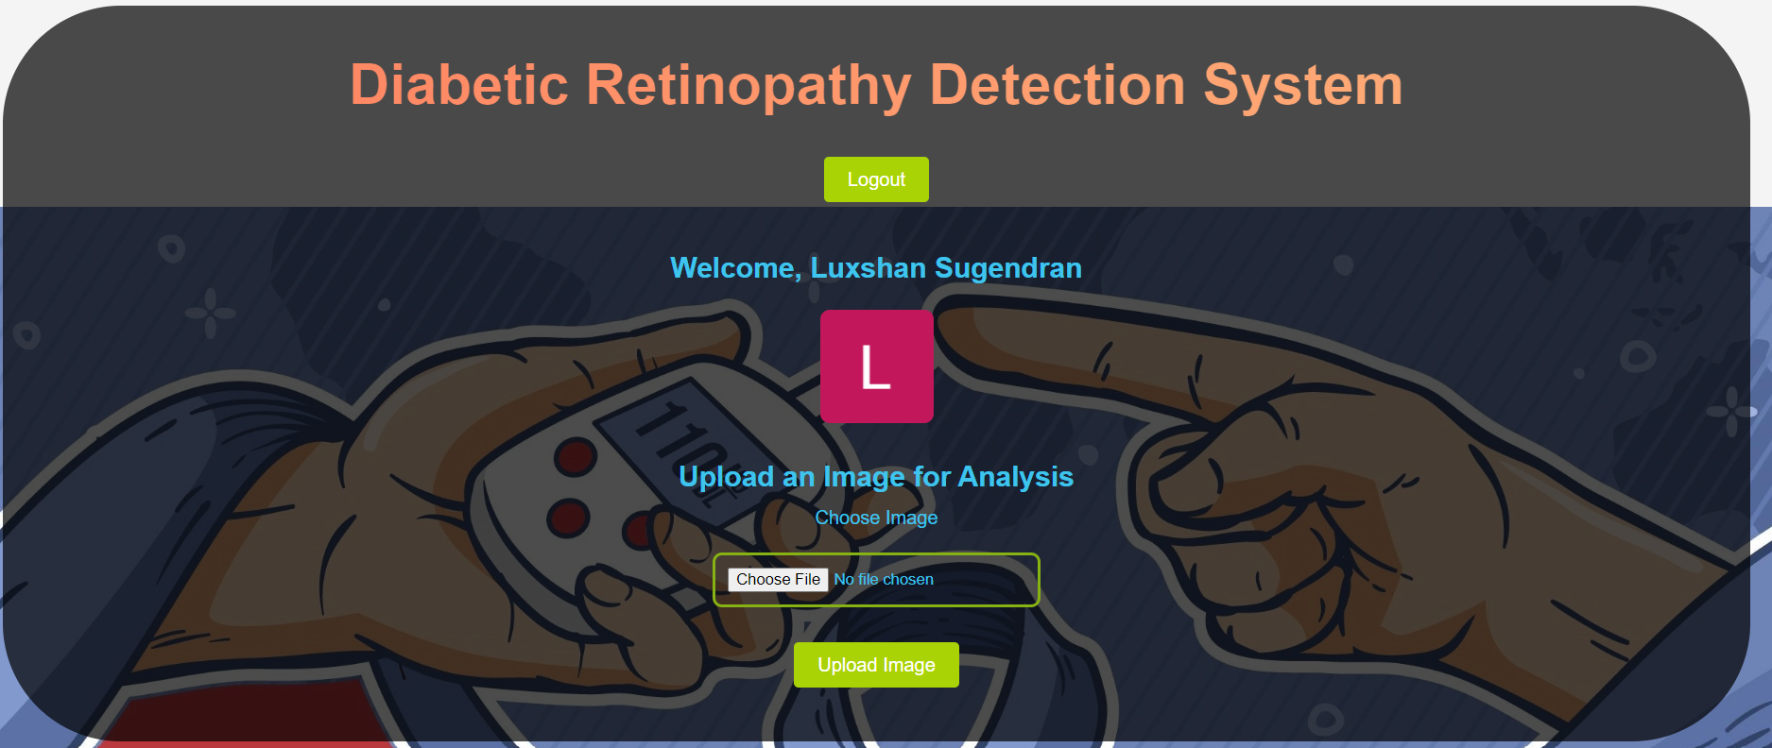
System Architecture
Frontend Technologies:
Built using React.js for responsive and interactive UI.
Google Sign-In Integration: Utilizes Google OAuth API for authentication.

Slide 7
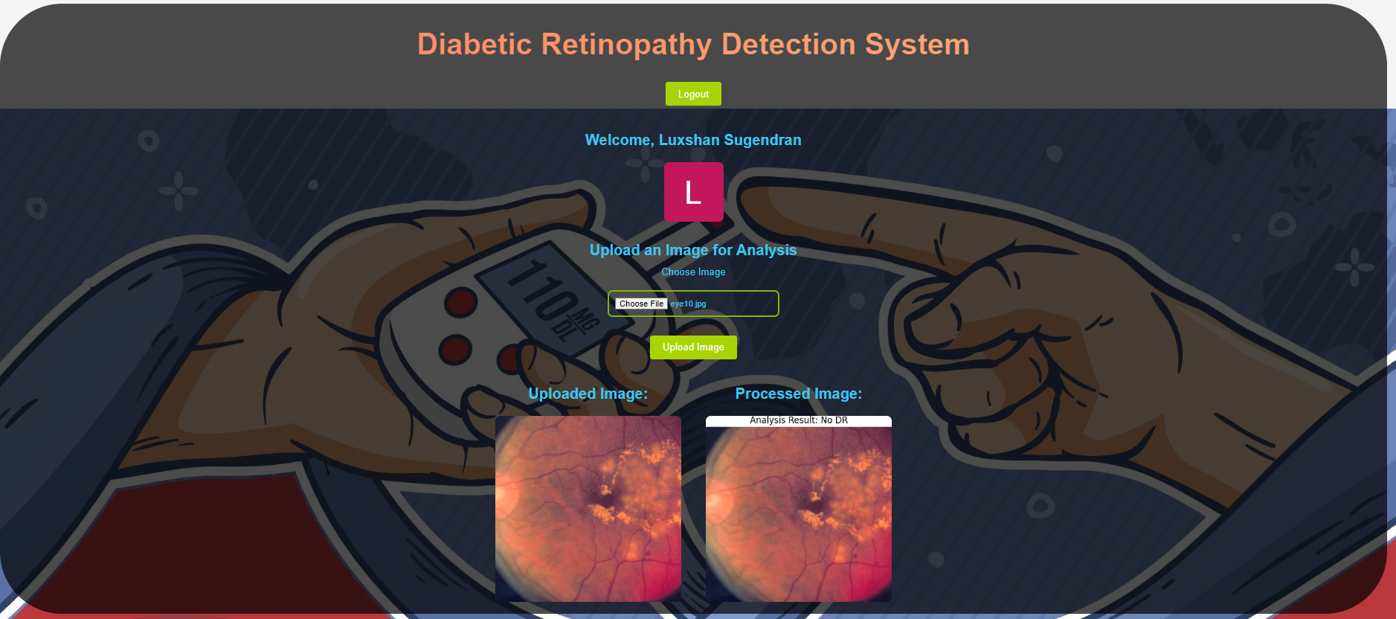
System Architecture

Slide 8
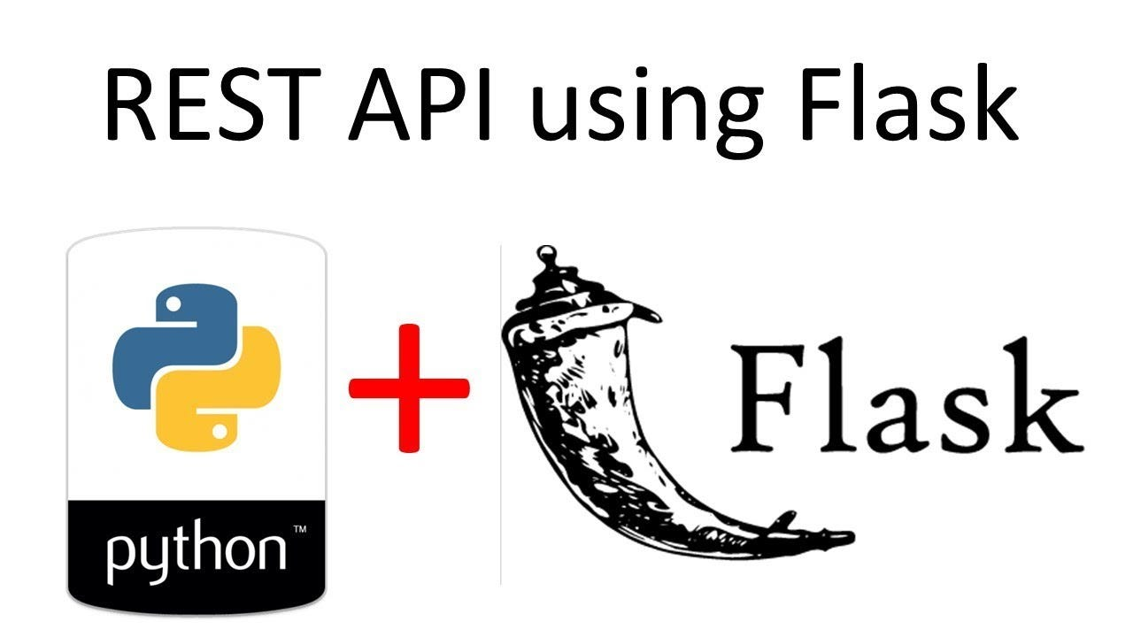
System Architecture
Backend Technologies:
Flask API requests.
Python with Flask for serving ML model and image processing for Machine Learning Integration.

Slide 9
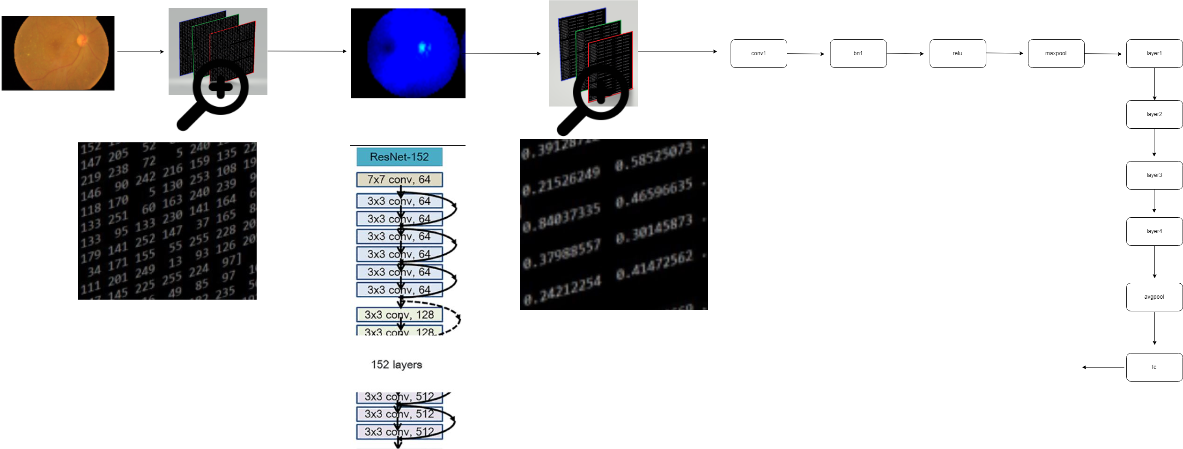
ML Model
PyTorch pretrained model from Kaggle dataset for diabetic retinopathy detection.
Base model – resnet152
Adding 3 layers (Linear FC, ReLU, Linear FC)
Freeze Certain Layers for evaluation purpose.
Model will predict 5 classes output ['No DR', 'Mild', 'Moderate', 'Severe’, 'Proliferative DR’ ].

Slide 10

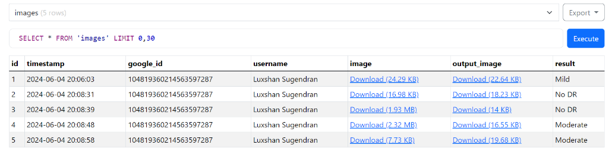
System Architecture
Database Storage:
Relational database SQLite for storing user data and analysis results.

Slide 11
Remaining Work
Security and Compliance
Cloud Server deployment

Slide 12

Thank You

